Slide 1
ROS Review and Actions
actionlib and tuning parameters

Slide 2
Review

Slide 3
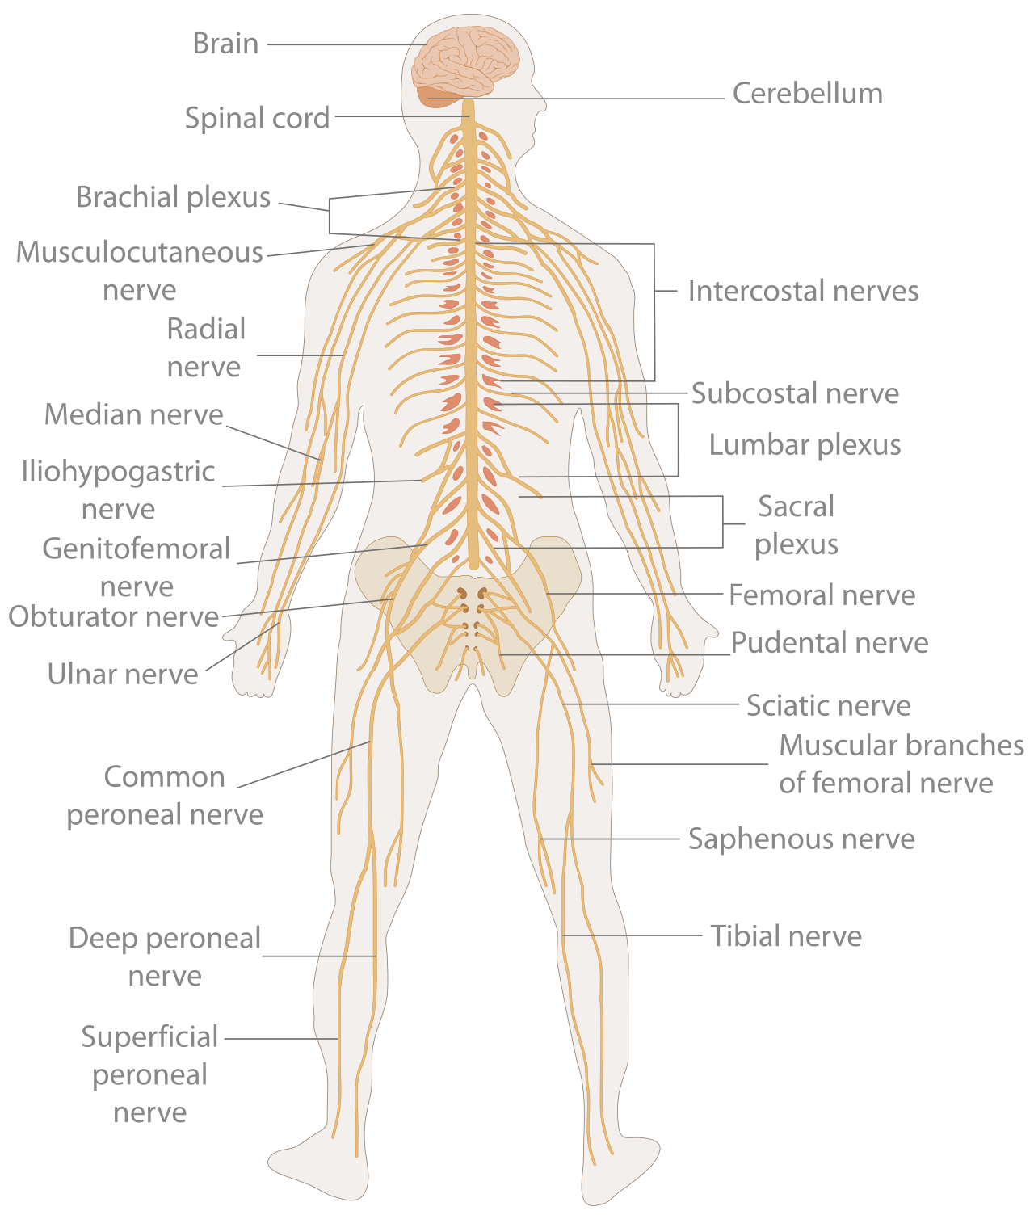
What does ROS do?
At runtime, ROS acts as the nervous system of the robot
ROS is the framework for controlling and coordinating the many components (sensors, motors, tools, logic) that make up the robot
Individual components are called nodes
Nodes can interface with hardware, provide interfaces for users, perform operations, and communicate with other nodes

Slide 4
Node Communication
ROS nodes typically communicate by sending and receiving messages on various topics
Nodes can also request messages and reply using various services
Nodes can communicate across machines, networks, programming languages, and operating systems

Slide 5
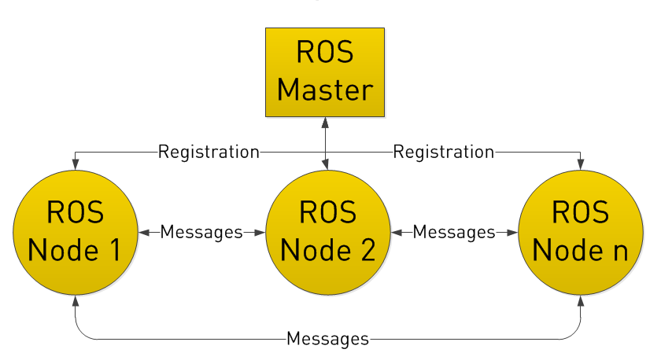
Node Structure
The ROS Master node handles naming and registration (publishing/subscribing) for all nodes in a ROS system. It must be active in order to run any other node
ROS nodes communicate with each other directly but must first register with the master to find each other
The ROS Master node is instantiated by running roscore or roslaunch in the terminal

Slide 6
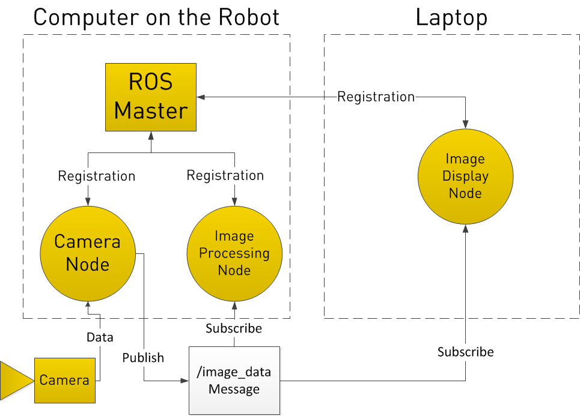
Publisher / Subscriber Model
A node can receive messages by registering a Subscriber and listening to a specific topic
A node can send messages by registering a Publisher and publishing to a specific topic
Messages are defined in .msg files

Slide 7
Message Example:
Header header
string name
geometry_msgs/PoseWithCovariance pose
geometry_msgs/TwistWithCovariance twist
int32 X=123
string STATE=“Indiana”

Slide 8
Publisher Example:
1 #!/usr/bin/env python
2
3 import rospy
4 from std_msgs.msg import String
5
6 def talker():
7 pub = rospy.Publisher('chatter', String, queue_size=10)
8 rospy.init_node('talker', anonymous=True)
9 rate = rospy.Rate(10) # 10hz
10 while not rospy.is_shutdown():
11 hello_str = "hello world %s" % rospy.get_time()
12 rospy.loginfo(hello_str)
13 pub.publish(hello_str)
14 rate.sleep()
15
16 if __name__ == '__main__’:
17 try:
18 talker()
19 except rospy.ROSInterruptException:
20 pass

Slide 9
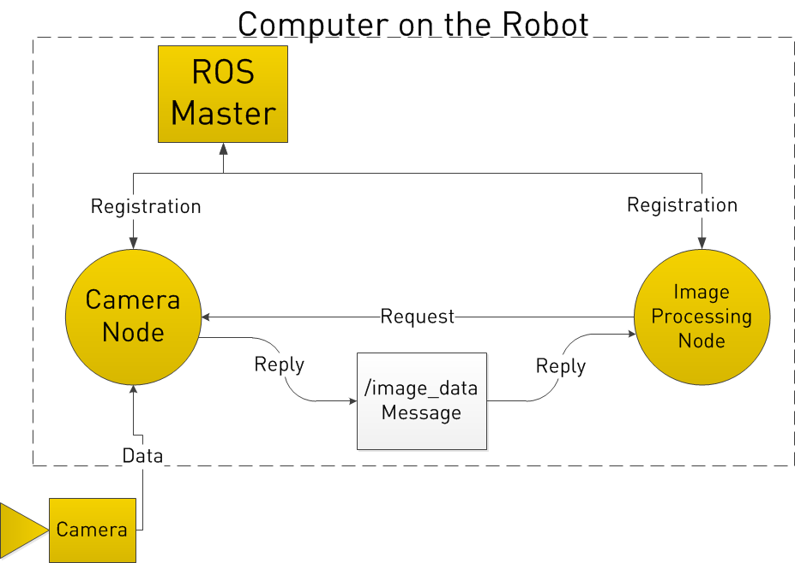
Request / Reply Model
Nodes can request a message at a specific time (synchronously) by registering a ServiceProxy
Nodes can reply to requests by registering a Service
Services are defined in .srv files

Slide 10
File System
Software in ROS is organized into packages
Packages can contain ROS nodes, ROS-independent libraries, datasets, configuration files, third-party software, and anything else needed to provide a useful module

Slide 11
ROS bash commands
rosed
roscd
rosls
rosnode
rostopic
rosservice
rosmsg
rospack
rosdep
rosrun
roslaunch
catkin_create_pkg
catkin_make
Edit a file in a ROS package
Navigate to a package or subdirectory
List files in a package or subdirectory
Work with active nodes
Work with topics
Work with services
Work with messages
Work with packages
Work with
Run a ROS package
Run a ROS launch file
create a catkin package
build a catkin package

Slide 12
ROS bash commands
rosnode info
kill
list
machine
ping
cleanup
print information about node
kill a running node
list active nodes
list nodes running on a given machine or list machines
test connectivity to a node
purge registration information of unreachable nodes

Slide 13
ROS bash commands
rostopic bw
delay
echo
find
hz
info
list
pub
type
display bandwidth used by topic
display delay of a topic
print messages to screen
find topics by type
display publishing rate of topic
print information about active topic
print information about active topics
publish data to topic
print topic type

Slide 14
Packages
Packages are directories that contain a package.xml file, they tend to look like this:
package_name/
include/package_name
msg/
src/package_name
srv/
scripts/
CMakeLists.txt
package.xml
CHANGELOG.rst
C++ include headers
Folder containing Message types (.msg)
Source files, especially Python source that are exported to other packages
Folder containing Service types (.srv)
Executable scripts
cmake build file for catkin
Description of package
Tracks changes to package

Slide 15
Catkin
catkin workspaces are used to keep packages organized and build packages
workspace_folder/
CMakeLists.txt
package1/
package.xml
CMakeLists.txt
…
package2/
package.xml
CMakeLists.txt
….

Slide 16
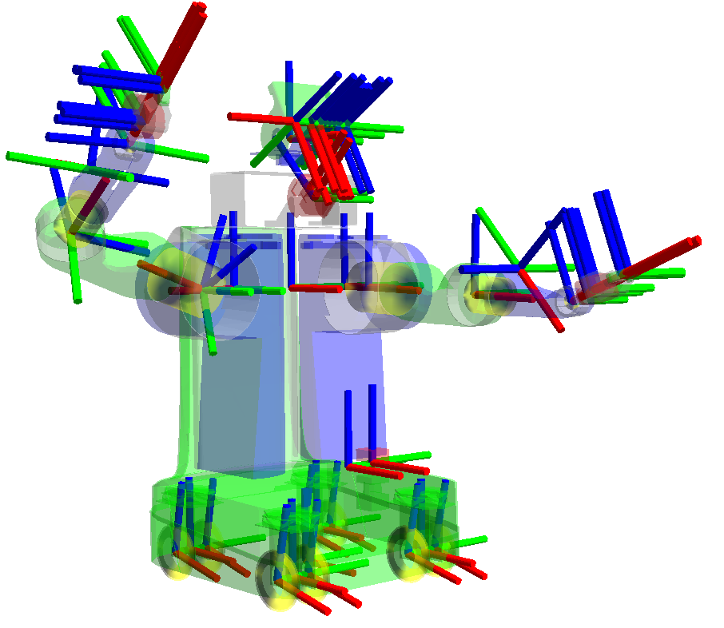
TF: Transform Library
Library for keeping track of where your robot is in the world and where each component of your robot is
Simulated and real robots must specify coordinate frames for sensors, motors, COM
tf stores the relationships between coordinate frames as Poses and handles transforms from one frame to another
ROS coordinate frames follow the right-hand rule: x points forward, y points left, z points up

Slide 17
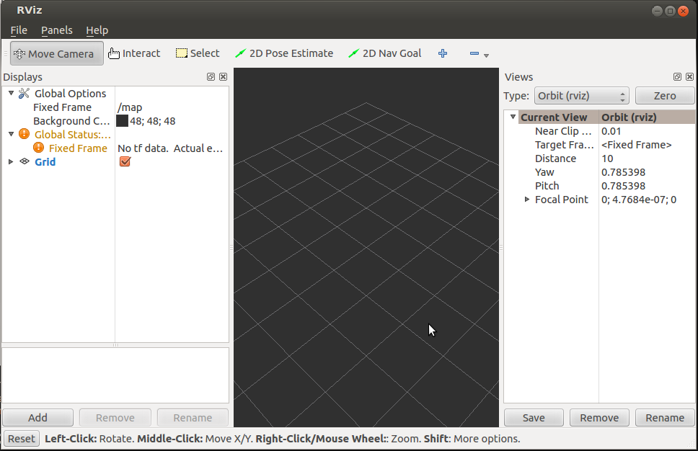
rviz
ROS Visualization tool

Slide 18
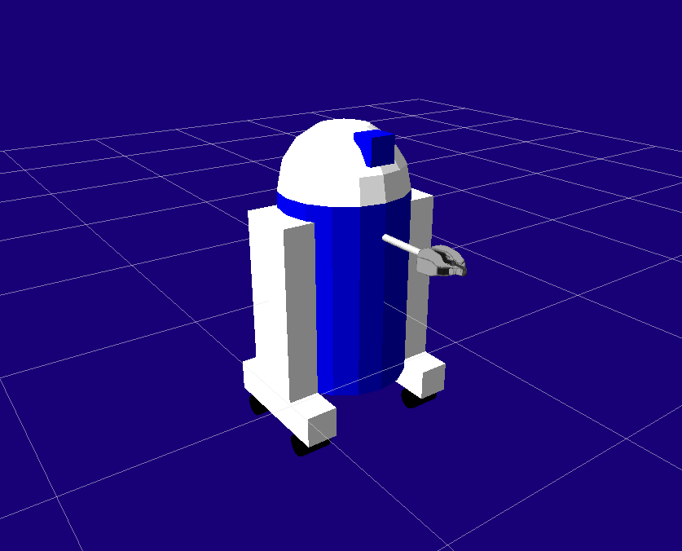
URDF: Unified Robot Description Format
URDF files specify a robot’s visual model, boundaries, physical properties, and tf frames
Used in visualization, simulation, and interaction of robots
Can include complex meshes created in 3D graphics editors for custom objects

Slide 19
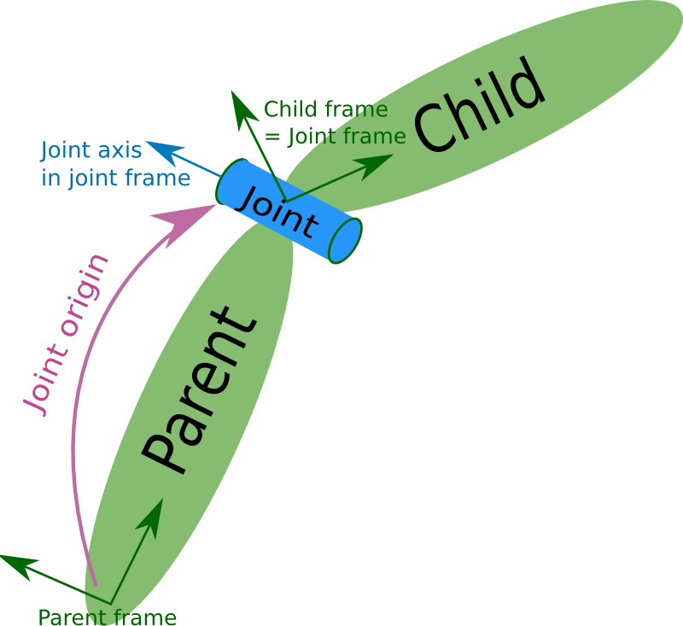
URDF: Joints
Revolute: a hinge joint that rotates along the axis and has a limited range
Continuous: a continuous hinge joint that rotates around the axis and has no upper and lower limits.
Prismatic: a sliding joint that slides along the axis, and has a limited range
Fixed: This is not really a joint because it cannot move. All degrees of freedom are locked.
Floating: This joint allows motion for all 6 degrees of freedom.
Planar: This joint allows motion in a plane perpendicular to the axis

Slide 20
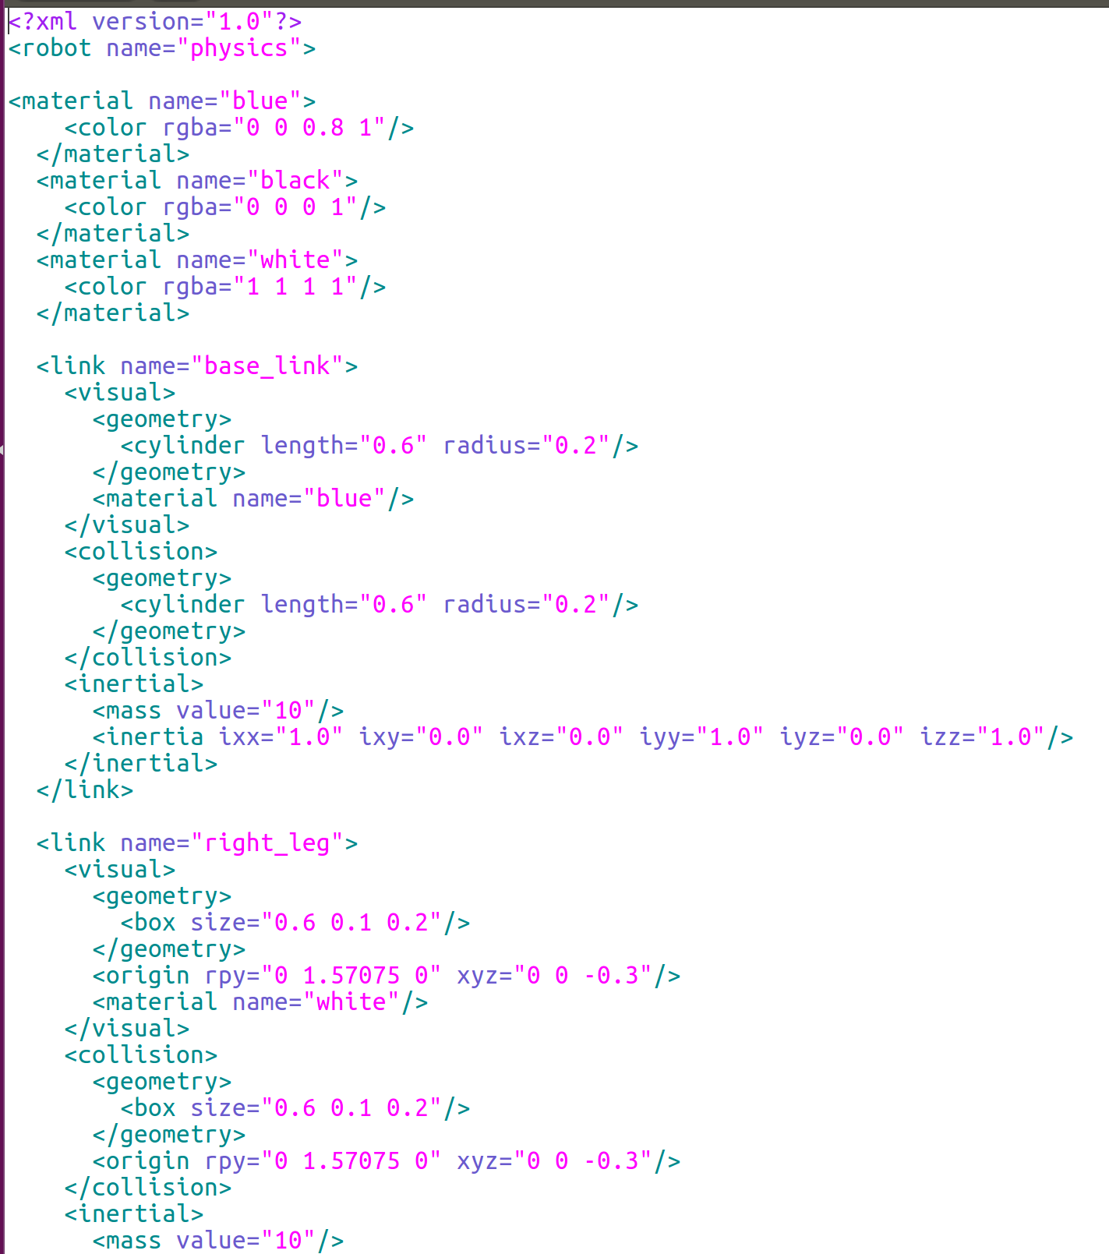
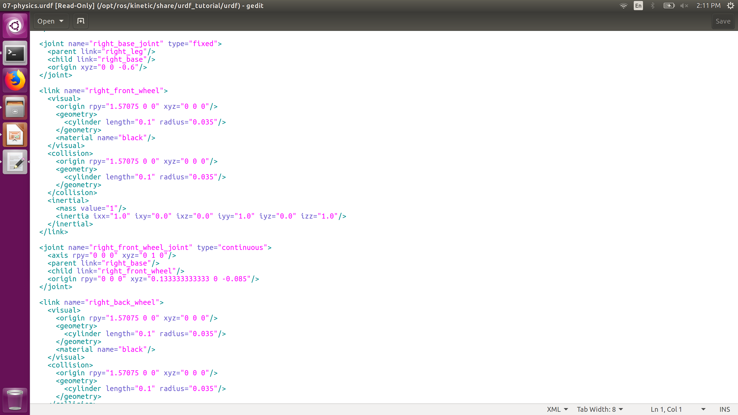
URDF Example

Slide 21
Today

Slide 22
Calibration

Slide 23
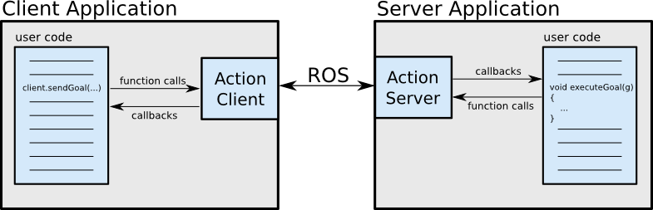
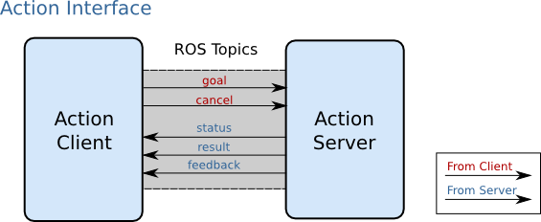
Actionlib
The actionlib package provides tools for initiating long-running tasks, getting feedback, and cancelling tasks
It uses actions to define the goal, feedback, and final output of a task
Ex. Request a robot moves to a point (goal), along the way send its current position (feedback), when it arrives it send a picture from the camera (result)
http://wiki.ros.org/actionlib

Slide 24
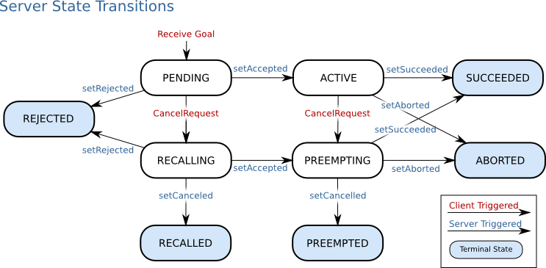
Actionlib: Server

Slide 25
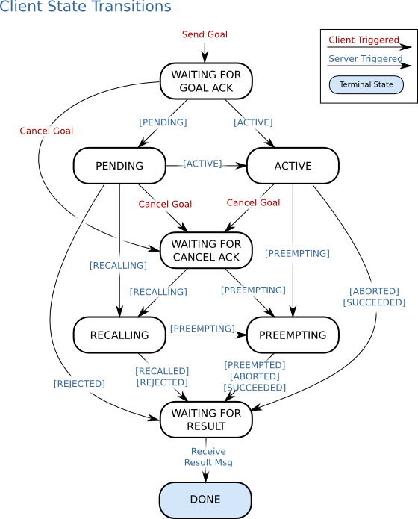
Actionlib: Client
1 #! /usr/bin/env python
2
3 import roslib
4 roslib.load_manifest('my_pkg_name')
5 import rospy
6 import actionlib
7
8 from chores.msg import DoDishesAction, DoDishesGoal
9
10 if __name__ == '__main__':
11 rospy.init_node('do_dishes_client')
12 client = actionlib.SimpleActionClient('do_dishes', DoDishesAction)
13 client.wait_for_server()
14
15 goal = DoDishesGoal()
16 # Fill in the goal here
17 client.send_goal(goal)
18 client.wait_for_result(rospy.Duration.from_sec(5.0))

Slide 26
Lab Activity 5
Grab a computer, use your own, or partner up!
If you will be using your own laptop and haven’t installed Ubuntu or ROS please do so. See the installation guide on the course wiki page or the instructors for help
Open Terminal
Go to http://wiki.ros.org/actionlib/Tutorials
Follow 1. Workspace Setup
Then follow exercises 4, 5, and 3 under 2. Beginner Tutorials
WIFI: Westgate-STEM PASSWORD: TheDesignProcess

